Slide 1




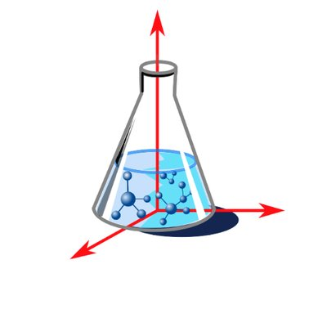
Hands on data: Chemometrics
ANTARES 7th ANNUAL WORKSHOP
27th October, Mercedes Bertotto
Notes:
We continue Hennie’s work

Slide 2
Workshop agenda: Chemometrics
Introduction to Chemometrics
Exploratory analysis and Outlier Detection
Pretreatments on raw spectra
Feature selection
Cross validation or Data Split
Discrimination (PLSDA)
Hands on Data (30 min)

Slide 3
Part 1: Introduction

Slide 4
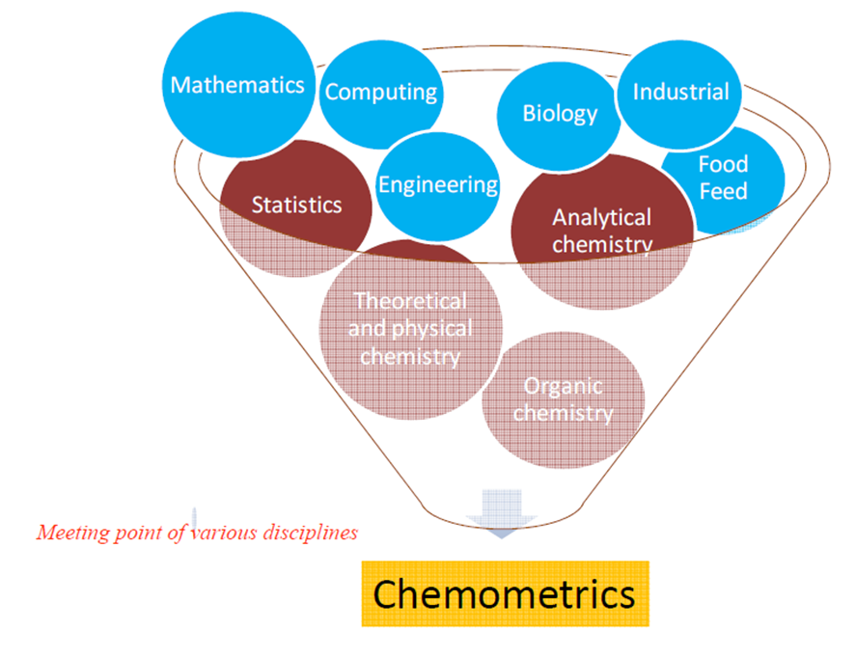
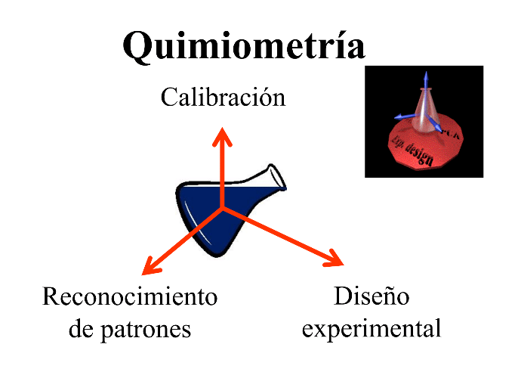
Chemometrics
“Chemometrics is the chemical discipline that uses mathematical, statistical, and other methods employing formal logic to design or select optimal measurement procedures and experiments, and to provide maximum relevant chemical information by analyzing chemical data“. D. L. Massart (1941-2005)
Multivariate calibration
Pattern recognition
Design of Experiments
Notes:
This is the currently accepted definition in the NIR community
Chemometrics is a discipline that uses mathematics, statistics and computer science to address problems related to:
Patter recognition
Multivariate calibration
Design of experiments
Therefore, it is inherently interdisciplinary.
It is used to solve problems in
chemistry, biochemistry, medicine, biology and chemical engineering.

Slide 5

Why Chemometrics? Why Linear Algebra?
NIR spectra are of high dimension
The data are highly correlated (collinearity problem) and obscured by the presence of overlapping absorbances, harmonics, and combination bands
Spectra are often complicated by light scattering and other physical effects
Multivariate methods (chemometrics) are required to address these issues
“Linear algebra is the language of chemometrics. To understand most chemometric techniques, a basic understanding of linear algebra is required." (Wise and Gallagher, 1998)
Notes:
Nowadays, analytical methods provide data with high dimensionality
Near infrared spectroscoppy, Raman, MIR, CGMS,
3 different problems
high number of variables that are correlated
We work with overtones and combination bands,, overlapping bands
Spectra are influenced by physical effects
That is why, we need multivariate analysis to address these issues.

Slide 6
Statistics versus chemometrics
Focus on distributions
Inference based on hypothesis tests of parameters
Density estimation
Mandatory courses at every biological education
Focus on individual samples
Inferences based on future performance
Clustering
Voluntary course at only few institutions
Source: International School of Chemometrics 2023
Morten Arendt Rasmussen
Notes:
Chemometrics is not statistics
Chemometrics focus on individual samples
It is used to analyse multivariate data in a multivariate way
Takes into account corretation of variables with high dimensionality
Calibrates, validates and evaluates the performance of the models
This is good to know in order to apply the proper methodology

Slide 7
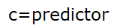
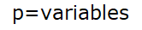
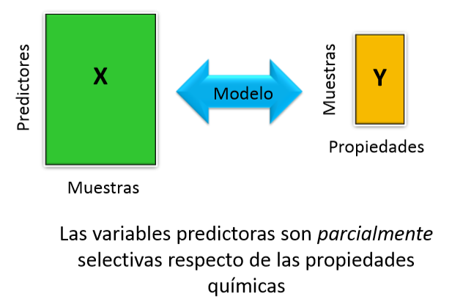

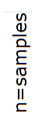

Multivariate analysis
Model
The predictor variables are partially selective of the chemical properties
Notes:
In univariate quantitative analysis, the analyte concentration is obtained by introducing a univariate instrumental signal into a calibration curve. It only works if the predictor variable is specific to the chemical property. On the other hand, in multivariate quantitative analysis, the property is obtained using multivariate instrumental signals and a specific algorithm. The predictor variables are partially selective of the chemical properties.
Samples are referred to as OBJECTS
- Measurement results (e.g. concentration, absorbances, …) are referred
to as VARIABLES
-A data table of K variables and M objects is referred to as a DATA
MATRIX OF SIZE MxK

Slide 8
GOOD MODELING PRACTICES (GMP)
Collection of a set of representative samples
Creating a calibration set
Measurement of spectra of the entire collection
Creating a validation set
Analysis of all samples by a reference method
Establishment of a predictive model through the application of multidimensional statistical methods
Validation of the model on the validation set
Serial analysis of unknown samples
Add new samples to the collection
YES
Does the equipment work correctly?
Were the control samples analyzed accurately?
Instrument repair/check
YES
YES
Are the control samples representative?
Check the reference dosage
Notes:
"BPMs (Best Practices in Chemometrics) aim to explain and describe the stages to be carried out when implementing a general analytical model.
Study the objective of the work and the best way to achieve it.
Samples: they must be measured under standardized conditions. They should be representative of what will be measured later. They should cover all the variability that we expect in the routine samples.
Variability can be contained in many factors, such as biological sample variability, geographical origin, flowering date, or harvest date.
The stages presented here are based on the existence of predictive variables in the form of spectra (signals of various origins: IR spectroscopy, Raman, fluorescence, etc.).
Commencement: The data collection stage must also adhere to certain rules to be effective.
From the collected data, a predictive model will be constructed while taking precautions to ensure practical validity. The established model can be applied in practice, and its validity must be regularly verified.
Pre-data collection stage: Reflect on the analysis strategy to be implemented to solve a problem. It should be as simple as possible: there are industrial situations where it is recommended to directly test the product's compliance with a reference spectral collection. Spectral distance.
Study relevance, accuracy, the domain of application, etc. Choose the reference method. Select a sufficient number of representative samples from the population. These samples will then be divided into two sets: calibration and validation. A third set of data can be extracted from the initial samples or acquired specifically for testing purposes.
The results of the analysis of the calibration samples are used to create a regression or discrimination model. This model is then applied to the results of the validation samples and tested with the test set. After validation, the predictive model can be used in routine.
The proper functioning of the spectroscope and the chemometric model should be regularly monitored and potentially adjusted."

Slide 9
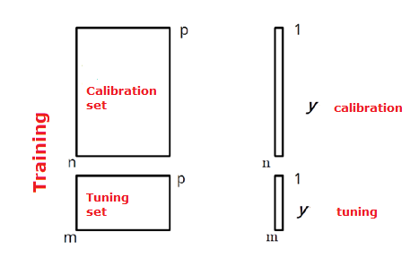
Data Set Preparation
GOOD MODELING PRACTICES (GMP)
Notes:
Samples can be split in two or three sets, if we split in three there are two options.
Everything is possible, but there are two things not possible
Not to validate with idependent samples
To use the tuning set as validation set
Use the calibration set to create the model, use the tuning set to tune the parameters of that model. Then, validate the trained model in the test set.
Another option is to calibrate and tune the model with the calibration set, using cross validation or splitting it again. Then perform and internal validation with samples from the same data set, and a external validation with new samples. Moreover, you can also do external validation with the same dataset, in that case you split the data set in three.
The first stage in establishing a predictive model involves splitting the spectral collection into two sets: learning and test sets. The first will be used to fine-tune the predictive model, and the test set will be used to estimate the quality of the predictive model.
The term 'set' refers to spectra selected using an alternative spectroscopic method, and the term 'value' refers to the reference method.
The division can be performed using different algorithms that we will see later on.
Con respecto al CovSel, yo use el set de validacion para tunear el numero de variables. En ese caso, un nuevo juego de datos seria necesario
Si usamos el set para tunear los parametros, entonces no lo podemos usar como validacion, y necesitamos un nuevo set de datos independiente para validar el modelo
You have used the validation set to tune the parameters, then it is not longer a validation set.
You cannot use it as a validation set as well, their performance as a validation set is compromised, because you have used it to tune the parameters
You have used this data set in order to tune the parameters, therefore you cannot use it as a validation set
If you have used the validation set to tune the parameters, then it is no longer a validation set
This model is not properly validated. You need to validate this model in a correct manner
You need to validate the model with new, independent samples that have not been used to tune the parameters
You need to validate the model with new, new totally independent samples, samples that were never seen by the model

Slide 10
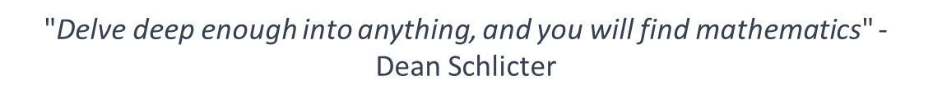
Part 2: Exploratory analysis and Outlier Detection

Slide 11
Reducing dimensionality
Identifying and Removing Irrelevant Variables to:
Enhance Computational Performance
Improve Model Interpretability and Result Comprehension
Avoid overfitting and collinearity
One way to solve the problem: Transforming the initial set of variables into a lower-dimensional set while retaining most of the information
Notes:
Noise, collinearity and overfitting
Sometimes we have variables that describe perfectly well the calibration set, but then cannot be generalized to the validation set…that is overfitting
More representative observations improve the model, but a higher number of variables not necessarily
More number of samples always improve the model, make it more robust

Slide 12
Principal Component Analysis (PCA)
Objectives:
Exploration/ Description/ Visualization
Dimensionality Reduction
Preparation and Cleaning (Outlier Identification, Noise)
Discrimination of Individual Groups
Determination of Relationships Among Individuals
Time evolution of scores is used to detect deviations in process monitoring
Preliminary Stage for Further Chemometric Treatment
Notes:
An ACP (Principal Component Analysis) serves, first and foremost, to explore or describe a high-dimensional multivariate dataset, meaning a dataset with a large number of variables (dimensionality reduction). Visualizing the results in a reduced space, such as a plane, allows for summarizing the information contained in a dataset.
It also serves to clean and prepare the dataset before applying any other treatments. The identification of outliers is performed in a multivariate manner. PCA is an essential preliminary step for any multivariate data analysis. It helps extract information from a dataset by separating both random and systematic noise.
PCA is also a tool for identifying groups of similar individuals within a dataset. The representation of proximity between individuals shows those individuals who behave similarly concerning the measured variables.
Just as the proximity between individuals is highlighted, the duality of individuals and variables in PCA allows for quantifying the correlations between the measured variables in a dataset.
In some cases, PCA serves as a preliminary step before further chemometric analysis. For instance, PCA can be conducted before unsupervised classification to reduce the initial dimensionality of the dataset. Some discrimination methods, such as SIMCA (Soft Independent Modeling of Class Analogies), use PCA for modeling each class.
Finally, in certain process monitoring applications, the time evolution of scores derived from PCA is used to detect deviations or abnormal events occurring during the process.
1) Visualizing the results in a reduced space, allows to summarize information contained in the dataset
2) Detection of outliers is performed in a multivariate manner
3) Dimensionality reduction, some algorithms cannot operate with more variables than samples
4) Some analysis are easily done using Principal Components instead of variables
5) PCA scores can be useful for process monitoring, as they show abnormal deviations
6) Clusters can be useful for further classification, when we do not know the labelling, it can give insight into relationships among individuals.

Slide 13
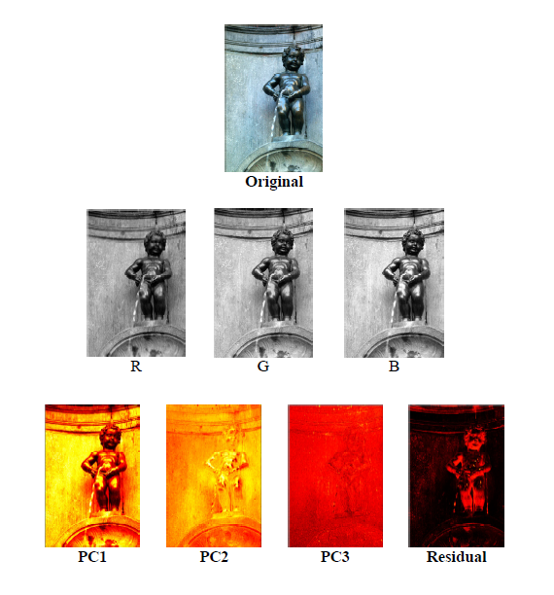
Principal Component Analysis (PCA)
Source: ChemFlow-FUN (France Université Numerique)
Notes:
"Describe the variation in multivariate data through a small number of uncorrelated variables (Principal Components, PC).
Combines the original variables into a set of new variables in a way that the most information in the original data prevails in the new variables.
Reduces dimensionality while preserving the maximum variance.
The PCs are uncorrelated and are ordered in a way that the first ones retain most of the variation present in the original set of variables.
New Latent Variables are constructed, variables that had not been measured
The original variables are proyected into new Latent Variables

Slide 14
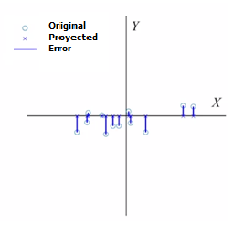
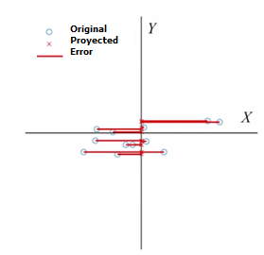
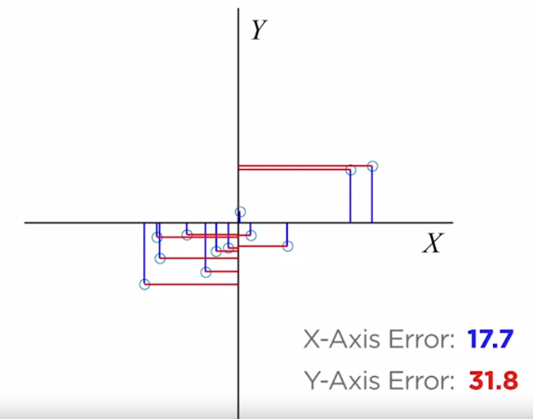
Principal Component Analysis (PCA)
Error de proyección total: 11.3
Error de proyección total: 34,5
Notes:
When using a variance threshold to eliminate a feature Y, the number of features, also known as the dimensionality of the feature set, is reduced by one. Geometrically, this corresponds to two-dimensional data, x-y, being projected onto the axis of the remaining feature X. A measure of the lost information is the projection error, which is the total distance between the original data points and the projected ones. For this feature set, it's clear that the error incurred when projecting onto the x-axis is much smaller than if we had projected onto the y-axis instead. When looking at a sample from the second feature set, it's evident that the projection errors will be large for both the x and y axes, and neither axis will minimize the error.“ So what can we do?

Slide 15
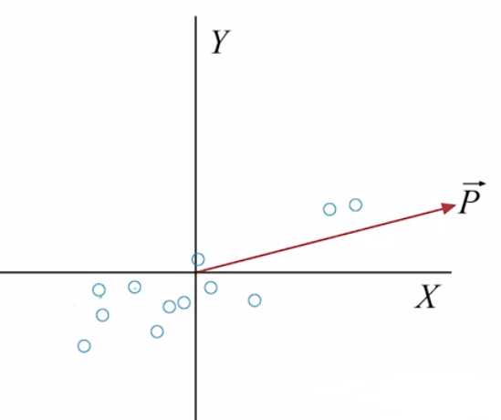
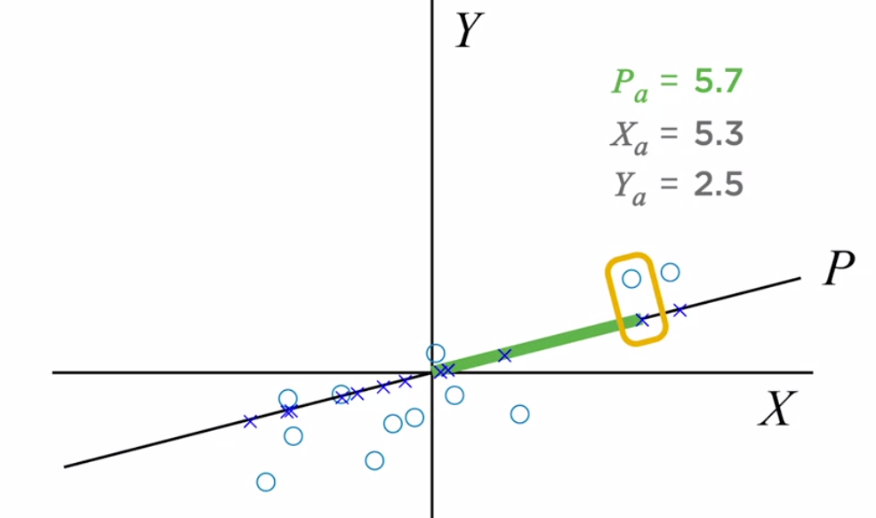
Principal Component Analysis (PCA)
Notes:
However, we can minimize the projection error by defining a new axis. The direction of this special axis is called the first principal component of the feature set. Principal components have a couple of properties that make them especially useful for dimensionality reduction.
They determine the axis direction that minimizes the projection error, and as a result, this is also the direction of maximum variance.
In this example, since the principal component axes capture most of the variance, you can use it to define a new feature, P. You can then replace X and Y with P, reducing the dimensionality of the feature set by one. The values of the new entity are determined by projecting the values of the original entity onto the new axis and measuring the signed distance from the origin to each projection. These values are commonly known as the scores of the principal components."

Slide 16
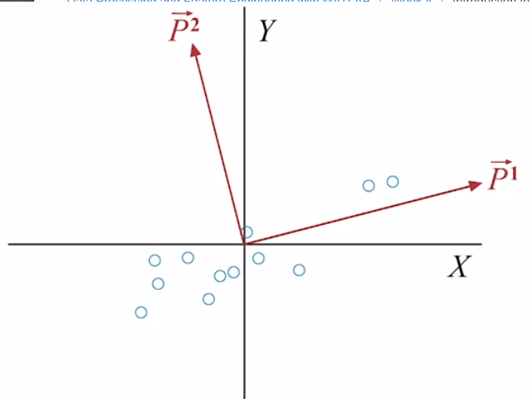
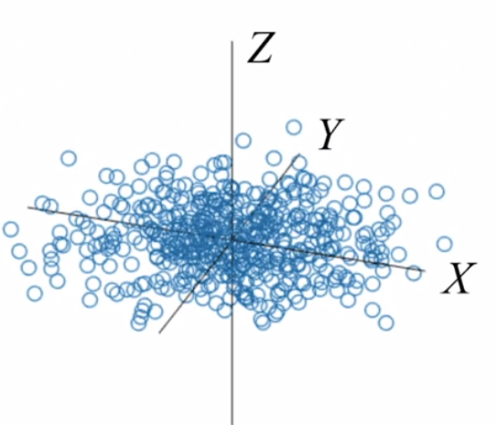
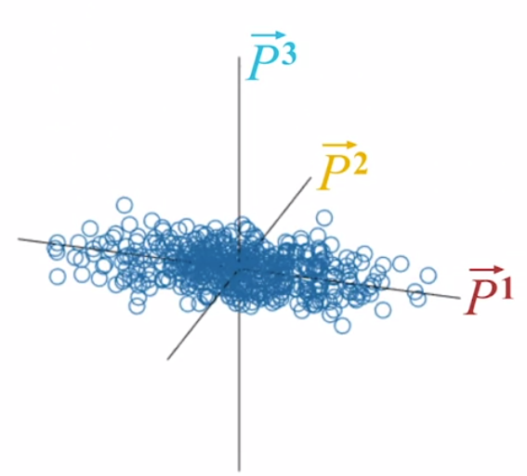
Principal Component Analysis (PCA)
Notes:
So far, we've only discussed the first principal component. The total number of principal components is equal to the dimensionality of the feature set. The second principal component is the direction of maximum variance that the first principal component doesn't account for; therefore, its direction is orthogonal to the first principal component. In more than two dimensions, the principal components are determined in decreasing variance order as follows. Start by finding the first principal component. The second principal component lies in the direction of maximum variance among all directions orthogonal to the first principal component. The third principal component is the direction of maximum variance among all directions orthogonal to the first two principal components. This process continues until only one orthogonal direction remains, which becomes the final principal component.
The result is a new coordinate system where the original axes have been rotated to maximize variance along the new axes.
Direction of maximum variance that the first principal component does not account for

Slide 17
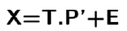
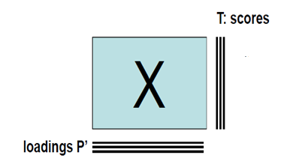
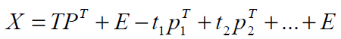
PCA: Matrix decomposition
(N x P)
(N x A)
A: Number of PCs
(P x A)
Notes:
The initial data table, i.e., the (N x P) dimension matrix X, is expressed as the product of the matrix T of scores (or factorial coordinates), with dimensions (N x A), where A is the number of retained principal components, and the transposition of the matrix P of loadings, with dimensions (P x A). Additionally, the matrix E, representing the residual variance, with dimensions (N x P), is included. It's worth noting that A, the number of retained principal components for the model, is typically much smaller than N and P. In fact, it's a reduction in dimensionality.
Scores: Each Principal Component represents a specific percentage of variance explained by the model, in relation to the total variance in the dataset, which sums up to 100%. The Principal Components are always ordered in decreasing order of the explained variance percentage.
Loadings: They represent the initial variables in the vector space constructed around the Principal Components. The distance of the projection of an initial variable onto the Principal Components corresponds to a loading or factorial contribution, meaning its weight or contribution or influence in building the PCs. The cosine of the angle formed between an initial variable and a PC corresponds to the correlation between both vectors.
Remember that a Principal Component is a linear combination of initial variables. The loadings correspond to the parameters 'p' in this equation.

Slide 18
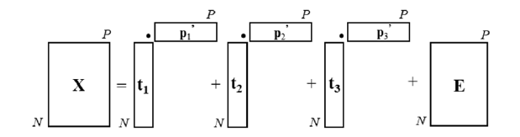
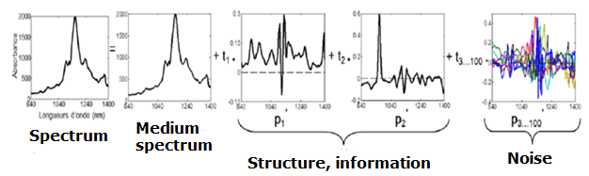
PCA: Matrix decomposition
Notes:
PCA can also be explained in terms of spectral data.
A measured spectrum is decomposed component by component as the product of a score (or factorial coordinate) and a loading, which is seen as a spectrum.
This loading represents the useful information. The residual variance matrix contains the unexplained part of the signal, i.e., the noise.

Slide 19
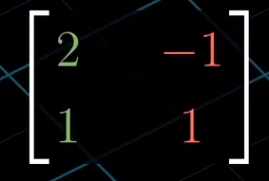
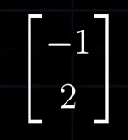
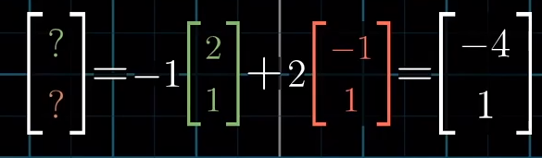
Change of basis: Linear transformation
Vector in our “language”
Transformation
Vector in another “language”
Notes:
La primera columna describe el sitio a donde cae el primer vector base
Segunda columna es donde cae el vector base. Una matrix describe una transformacion, si tenemos un vector especifico, podemos saber a donde la transformacion lleva ese vector
Multiplicación matriz-vector. Matriz cuyas columnas representan los vectores de la base de mi amiga, en nuestro idioma.
Antes de la TL, se piensa en el vector como una combinación lineal de los vectores, -1 por i sombrerito mas 2 por j sombrerito.
El vector resultante, será la misma combinación lineal, pero de los nuevos vectores de la base. Menos una vez, el lugar a donde cae i sombrerito, mas dos veces el lugar a donde cae j sombrerito-
Si tengo un vector en R2, tenemos una manera estándar de describirlo en coordenadas. En este caso, el vector tiene coordenadas [-1,2], lo que significa que ir desde su origen hasta su punta requiere moverse una unidad hacia la izquierda y dos unidades hacia arriba. Pero la forma más correcta en el álgebra lineal de describir coordenadas, es pensarlo en escalares, algo que estira o que encoge vectores, pensando en la primera coordenada como escalar de i, y en la segunda coordenada como escalar de j. La suma vectorial da los dos vectores escalados.
Asumciones implicitas en esto: el hecho que el primer numero indica movimiento hacia la derecha, y el segundo hacia arriba. Cuánta distancia es exactamente una unidad. Todas estas asumpciones están asociadas a la elección de i y de j como los vectores cuyas coordenadas se supone que debemos escalar.
La matriz de cambio de base, puede ser interpretada como una transformación lineal.
-1 veces el vector en donde termina i más dos veces el vector en donde termina j después de esa transformacion

Slide 20
Eigenvalues and eigenvectors
An eigenvalue of a matrix is a scalar that represents how a particular transformation, described by that matrix, stretches or compresses a vector in space
Eigenvalues quantify how much the direction of a vector changes when it is multiplied by a matrix
if A is a square matrix, and λ is a scalar, then λ is an eigenvalue of A if there exists a non-zero vector v (called an eigenvector) such that the following equation holds:
A * v = λ * v
The value λ is the eigenvalue associated with the eigenvector v
Notes:
Eigenvalues are a fundamental concept in linear algebra and are associated with square matrices. An eigenvalue of a matrix is a scalar (a single number) that represents how a particular transformation, described by that matrix, stretches or compresses a vector in space. In other words, it quantifies how much the direction of a vector changes when it is multiplied by the matrix.
Mathematically, if A is a square matrix, and λ (the Greek letter lambda) is a scalar (a number), then λ is an eigenvalue of A if there exists a non-zero vector v (called an eigenvector) such that the following equation holds:
A * v = λ * v
Here, A * v represents the matrix-vector multiplication of A and v. This equation states that when you multiply the matrix A by the vector v, the result is a scaled version of the same vector v, with the scaling factor λ. The value λ is the eigenvalue associated with the eigenvector v
How much a linear transformation changes the direction of a vector
Every time we see a matrix, we should think that it is a linear transformation of a vector
A Linear transformation changes the direction of a vector
It helps to describe the vector in another coordinate system.
For example, if we have a vector in our coordinate system, and we need to express it in another language, we use the

Slide 21
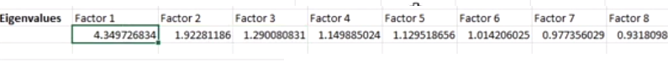
PCA explains the original variables through the strength of their relationship with the factors
The factors are extracted from the data sequentially
The factor that explains the highest % of variance is extracted first
Then, the factor that explains the second highest % of variance is extracted, and so on
The factors are orthogonal to each other
They have zero correlation between them, each representing something unique
Notes:
"Eigenvalues are particularly important. The number of factors to retain is a crucial decision in principal component analysis. The goal is to reduce the number of variables to a more manageable number of factors while retaining important information. A good way to make this decision is by examining the eigenvalues. The eigenvalues, one for each factor, add up to the number of variables in the input data. So, if, for example, we have 21 input data variables, the eigenvalues would sum to 21 units of variance.
Principal component analysis seeks to explain individual variables through the strength of their relationships with underlying factors.
We're looking for factors that explain or underlie more than a single variable. Thus, a good criterion for determining how many factors to retain is if the eigenvalue of a factor is greater than one.
If so, it represents more than a single variable, which is why I decided to retain three factors. There are actually six factors in this dataset with eigenvalues greater than one, but the eigenvalues for four, five, and six are only slightly greater than one, so I decided to retain only three factors for the purpose of rotation. There are other ways to make this decision, but all are a mix of objective and subjective criteria.
There are many other reasons why eigenvalues and their accompanying eigenvectors are important. Among these reasons is that the factors are extracted from the data sequentially. The factor that explains the most variance is extracted first. Then, the factor that explains the second-highest degree of variance is extracted, and so on. Furthermore, the factors are all orthogonal to each other. That simply means that the factors have zero correlation with each other, and, in turn, that means that each factor measures something unique. There is no ambiguity about how variance is assigned to each factor. In an orthogonal solution, like the one we are working with here, any variation associated with one factor cannot be associated with any other factor. This is because of how the factors are extracted from the original set of variables.
How to perform PCA 1. Scale and center the original variables by the mean. Calculate the components, scores, and variances.
2. Next, apply the variance threshold so that only the high-variance components are retained. Another common approach is to set a percentage of the total variance to preserve, and then retain the minimum number of components that satisfy this condition
Apply the variance filter. Discard components below the variance threshold. Retain the minimum number of components that cover the target variance.
The scores of the retained components are a new set of features.

Slide 22
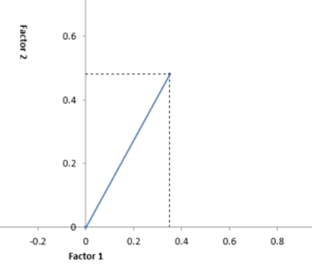
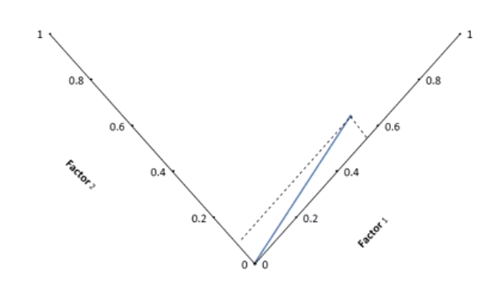
Factor rotation
Ideal
Real
The variables that are weakly related to the component are located near the center of the graph
Notes:
Ideally, we would like to have a subset of variables that are strongly related to one of the principal components, and then another subset that is strongly related to the other principal component.
Ideal situations don’t happen in our real world
This ideal situation rarely arises immediately after the factors have been extracted, but we can get closer to that ideal configuration by rotating the axes, keeping the data points where they are but turning the axes so that each variable is close to the center of the graph on one or more axes and far from the center of the graph only on one axis.
Once you have rotated the axes to that alignment, you will find individual variables that are strongly related to a component far from the center of the graph and you will find variables that are weakly related to the component near the origin point of its axes.

Slide 23
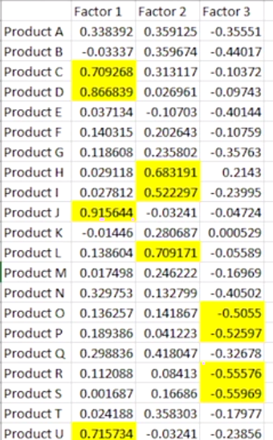
Loadings
Correlation coefficients
-1.0 : Perfect negative correlation
0.0: No correlation
1.0: Perfect positive correlation
In yellow: Loadings>0.5
The variables that load strongly on the same factor may share something in common. For example, products C, D, J, and U load strongly on the first factor. In this example, they are antibiotics
Notes:
Only three factors are displayed in columns B, C, and D. Remember that when I completed the principal components dialog box, I wanted to retain three factors. The original variables are shown in column A. The numbers in this table are called factor loadings. You can interpret them as if they were correlation coefficients ranging from a minimum of -1.0, indicating a perfect negative relationship, to 0.0, indicating no relationship, to 1.0, indicating a perfect positive relationship.
I have highlighted in yellow the factor loadings that exceed 0.5. These are stronger loadings, so you can see that products C, D, J, and U load quite strongly on the first factor. Similarly, product H, product I, and product L load quite strongly on the second factor. Four additional products, O, P, R, and S, load moderately on the third factor. Note that there are several products that start with products A, B, E, F, and G, and so on, that do not load strongly on any of the three factors. These products tend to exhibit unique variation, variation that they do not share with other products. You may well find that variables that load strongly on the same factor have something in common. For example, when the components are rotated, products C, D, J, and U load strongly on the first factor. The four products may be, for example, antibiotics. Products H, I, and L, which load strongly on the second factor, could be statins. At this point, if you feel comfortable with the principal component analysis so far, you can start analyzing individual records using factor scores instead of variable scores.

Slide 24
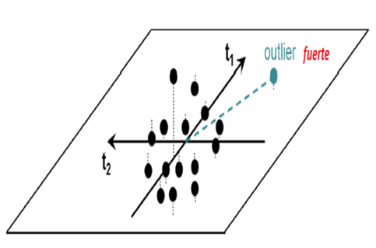
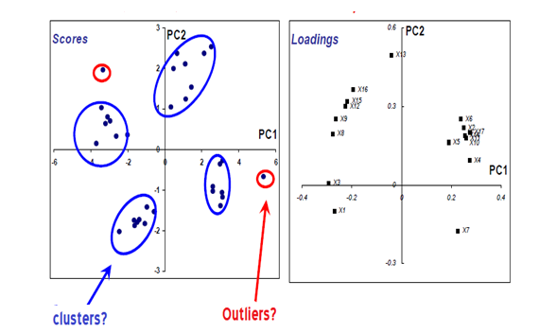
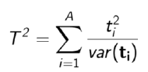
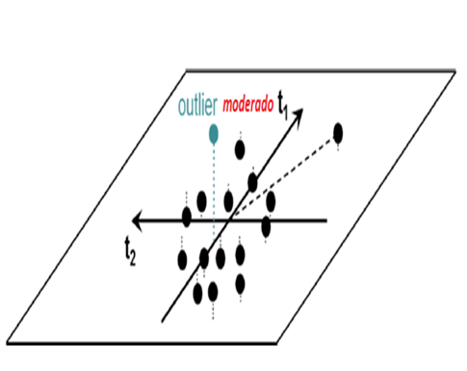
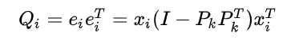
Outlier detection
La distancia de Hotelling or T2 corresponde a la distancia entre la proyección del individuo sobre el modelo y el centro del modelo
La distancia Q or residual
“The test hypotheses are:
Null hypothesis (H₀): the two samples are from populations with the same multivariate mean
Alternate hypothesis (H₁): the two samples are from populations with different multivariate means” https://www.statisticshowto.com/hotellings-t-squared/
Notes:
In other words, you can act as if the factors were observed variables and analyze different groups or clusters, based on a clustering analysis, according to their factor scores. Products A and B show unique variance, variance they do not share with other products. In reality, it's about understanding what variance these products have in common, what variance they share. That shared variance among products, or samples, is expressed in the factors."
"SCORE PLOT: Individual factor map. Proximity and difference between individuals. Loadings: Represent the original variables in the vector space constructed around the PCs. The distance of the projection of an original variable onto the PCs corresponds to a loading or factorial contribution, meaning its weight or its contribution or influence in building PCs. The cosine of the angle formed between an original variable and a PC corresponds to the correlation between both vectors
Q Residual represents the distance of the individual to the principal plane 1-2 of the model
Q- residual indicates how well each sample conforms to the PCA model. It is a measure of the difference, or residual between a sample and its projection into the principal components retained in the model. T2-Hotelling's distance, is a measure of the variation in each sample within the PCA model.
he first multivariate distance used is called the Hotelling's T-squared (T2) distance.
Suppose we have a PCA model with A principal components; Hotelling's T2 distance corresponds to the distance between the individual's projection onto the model and the center of the model. It is called a strong outlier because it is well modeled by the model, meaning it contributes strongly to the construction of the model. If it is removed from the analysis, the PCA model is significantly affected.
The second multivariate distance is called Q or residual distance. It directly represents the distance of the individual to the principal plane 1-2 of the model. An outlier with a high residual is poorly modeled by a PCA. If it is removed from the PCA model, the impact on the model will be low. The Q statistic indicates how well each sample conforms to the model. It is a measure of the difference, or residual, between a sample and its projection into the k factors retained in the model.
are summary statistics which help explain how well a model is describing a given sample,
Whereas Q residuals represent the magnitude of the variation remaining in each sample after projection through the model, the Hotelling's T² values represent a measure of the variation in each sample within the model. It indicates how far each sample is from the center (scores = 0) of the model.
T

Slide 25
Isolation Forest
We pick a column at random, and we select an arbitrary threshold within its range
We divide all the samples into two groups according to that threshold
There is a higher chance that the outlier point would end up in the smaller group or alone
This randomized splitting process is repeated recursively
The more common the point is, the more splits it will take to be isolated
Isolation depth: Number of partitions that it takes to isolate a point
One tree has a lot of variability
A final score is obtained by averaging results of many trees
Notes:
The intuition behind it is very simple: if there is an outlier in the data and we pick a column at random in which the value for the outlier point is different from the rest of the observations, and then we select an arbitrary threshold uniformly at random within the range of that column and divide all the points into two groups according to whether they are higher or lower than the randomly-chosen threshold for that column, then there is a higher chance that the outlier point would end up in the smaller partition than in the larger partition.
Of course, outliers are typically not defined by just having one extreme value in one column, and a good outlier detection method needs to look at the relationships between different variables and their combinations. One potential way to do this is by building a so-called “isolation tree”, which consists of repeating the randomized splitting process described above recursively (that is, we divide the points into two groups, then repeat the process in each of the two groups that are obtained, and continue repeating it on the new groups until no further split is possible or until meeting some other criteria).
OUTLIERS ARE EASIER TO ISOLATE, INLIERS ARE HARDER TO ISOLATE
Under this scheme, one can deduce that, the more common a point is, the more splits it will take to leave the point alone or in a smaller group compared to uncommon points - as such, one can think of the “isolation depth” (number of partitions that it takes to isolate a point, hence the name of the algorithm) in the isolation trees as a metric by which to measure the inlierness or outlierness of a point.
A single isolation tree has a lot of expected variability in the isolation depths that it will give to each observation, thus an ensemble of many such trees - an “isolation forest” - may be used instead for better results, with the final score obtained by averaging the results (the isolation depths) from many such trees.
There are many potential ways of improving upon the logic behind the procedure (for example, extrapolating an isolation depth after reaching a certain limit) and the resulting score can be standardized for easier usage, among many others - see the references for more details about the methodology.
Why choose isolation forests over the alternatives
Compared to other outlier/anomaly detection methods such as “local outlier factor” or “one-class support vector machines”, isolation forests have advantages in that they are:
Robust to the presence of outliers in training data.
Robust to multi-modal distributions.
Insensitive to the scales of variables.
Much faster to fit.
Invariant to the choice of distance metric (since it doesn’t use a distance metric in the first place).
The problems of swamping and masking have been studied extensively in anomaly
detection [Murphy 1951]. Swamping refers to situations where normal instances
are wrongly identifying as anomalies. It happens when the number of normal
instances increases or they become more scattered. Masking, on the other hand,
is the existence of too many anomalies concealing their own presence. It happens
when anomaly clusters become large and dense. Under these circumstances, many
anomaly detectors break down. Note that both swamping and masking effects are
results of too many data for the purpose of anomaly detection
iForest is excellent in handling the effects swamping and masking through significantly reduced
sub-samples.

Slide 26
Part 3: Pretreatments on Raw Spectra

Slide 27
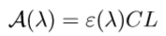
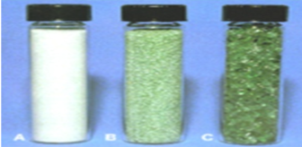
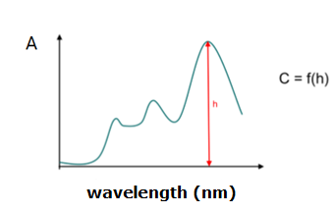
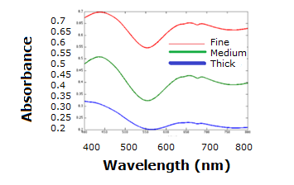
Near Infrared Spectroscopy
Ideal conditions
Real conditions
Lambert-Beer Law
.
Pretreatments eliminate spectral deformations to approach the pure contribution of the studied parameter
Notes:
Ideal conditions for IR spectroscopy correspond to the measurement of a transparent and low-concentration solution.
Under these conditions, for a completely transparent and low-concentration solution, the concentration of a compound of interest is directly proportional to its absorbance. The Lambert-Beer Law states that the absorbance of a compound at a given wavelength will be proportional to the concentration of the component, multiplied by the path length, and the molar absorptivity at that same wavelength, which is characteristic of each compound.
In FT-IR spectroscopy, this law applies to different wavelength values in the infrared spectrum. The different absorbances of the same compound as a function of its wavelengths can be plotted in the figure
The Beer-Lambert law is never used under ideal conditions. Its application is intended in other raw materials, such as flour, wood, and soil. The relationship between the spectrum and concentration is even more complicated. The Beer-Lambert law is not verified because the measured spectrum is distorted by numerous phenomena.
These phenomena are related to the concentrations of other compounds in the mixture, temperature, sample granularity, etc.
A very visual example is that of a green-colored glass, crushed to different granularities. We observe in the figure that the more crushed the glass is, the whiter it appears.
The color that appears in the equipment is directly proportional to the measured absorbance. An object that appears green has less absorbance in green (525nm) than in blue (480nm) and red (650nm). With a thicker glass, you observe less green and more blue and red.
The absorbance spectra measured for the three colors will be different, even though their chemical content is identical.
If we need to predict the physical parameter, then we should not use pretreatment to raw data

Slide 28
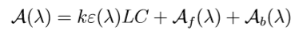
Real spectrum may be influenced by:
Multiplicative and additive effects
Photon diffusion
Measurement noise
Enlarges the medium length of the optical path by factor k
2) Will cause a certain number of photons to escape from the captor, creating a leak term
It is due to a set of random phenomena present throughout the measurement chain
Efecto aditivo
Efecto aditivo
Addiive effect
Notes:
Jean Michel Roger in 2019 explains how a signal is disturbed in the case of a real sample, when its spectrum is affected by photon scattering and measurement noise:
“In the case of a real sample, the spectrum is disturbed by photon scattering and measurement noise. Photon scattering (1) lengthens the average optical path length by a factor k (multiplicative effect); (2) leads a certain number of photons to escape from the sensor, which adds a leakage term per wavelength l (additive effect): Af (λ). Measurement noise is due to a set of random phenomena present throughout the measurement chain (stray light, electronic noise from the sensor, etc.). It results in an another additive term per wavelength Ab(λ)
Finally, the absorbance actually measured is assigned a multiplicative term and two additive terms:
A(λ) = kε(λ)LC + Af (λ) + Ab(λ) (Equation 1)
Where, A: Absorbance; λ: Wavelength; A(λ): Absorbance at a particular wavelength
k: multiplicative effect; ε: Molar absorption coefficient (M-1 cm-1); L: Optical path length (cm)
C: Molar concentration; Af (λ). Additive effect at a particular wavelength caused by a certain number of photons escaping from the sensor; Ab(λ). Additive effect at a particular wavelength caused by random phenomena”.
The different preprocessing strategies will consist in correcting as many of the three terms k, Af (λ), Ab(λ) as possible. (Jean-Michel Roger M. E., 2019)
It is important to know whether the data has been affected by a multiplicative effect or an additive effect or both. The preprocessing method to be used depends on its efficiency to remove the noise present in NIR spectra. For this reason, it is important to understand firstly very well the type of noise/effect present in each particular case.
It should be mentioned that it is possible to apply more than one pre-treatment sequentially. For example, a multiplicative scaling is often used together with a derivative.
The path length of light is often affected by sample thickness, measurement geometry (for non-scattering samples), or physical properties of samples, such as particle/droplet/fiber size and distribution (turbid samples
Data can be affected by multiplicative effect, additive effect of both

Slide 29
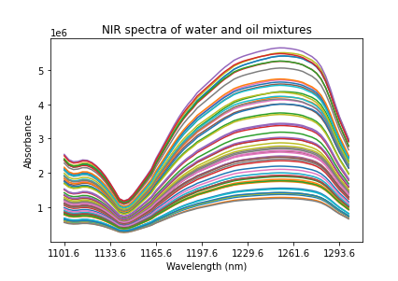
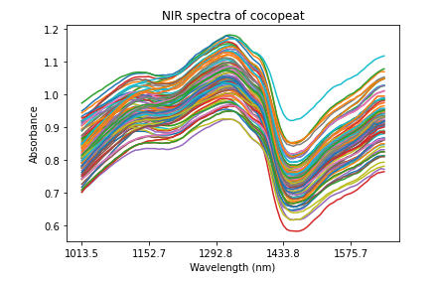
How to distinguish additive and multiplicative effects
NIR spectra of water and oil mixtures showing a multiplicative effect. Source: WUR.
NIR spectra showing an additive effect.
Source: WUR.
Notes:
Figure 1 shows an example of a pure multiplicative effect on mixtures of water and oil spectra. the multiplicative effect shows the greater the intensity, the greater the distribution of the spectra. Figure 1 shows in the left zone close to 1133.6 nm (x-axis) that the intensity levels have been little affected, whereas the intensity of the spectra in the central zone between 1197 and 1261 nm are more expanded.
When spectra are clearly affected by light scattering, an increase in light intensity with wavelengths in a certain spectral range can be observed. As mentioned above, the light does not fully impact the material to be analyzed, but is lost in the inter-particle spaces. This can happen when the particles do not have the same size, or when there is porosity or gases present in the sample (https://www.aunir.com/light-bites/illuminating-spectra-part-7/). Figure 2 shows an increasing baseline in an spectrum of fish bone, from 5000 cm-1 to 4000 cm-1
Figure 3 shows an example of a pure additive effect in spectra: the dispersion between spectra is the same in the studied spectral range.

Slide 30
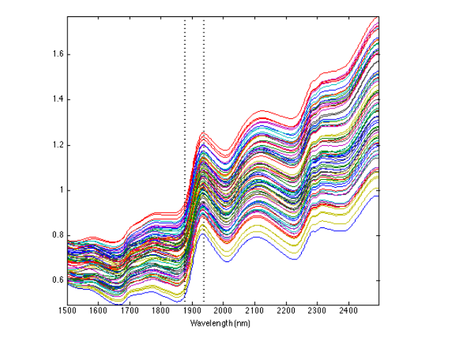
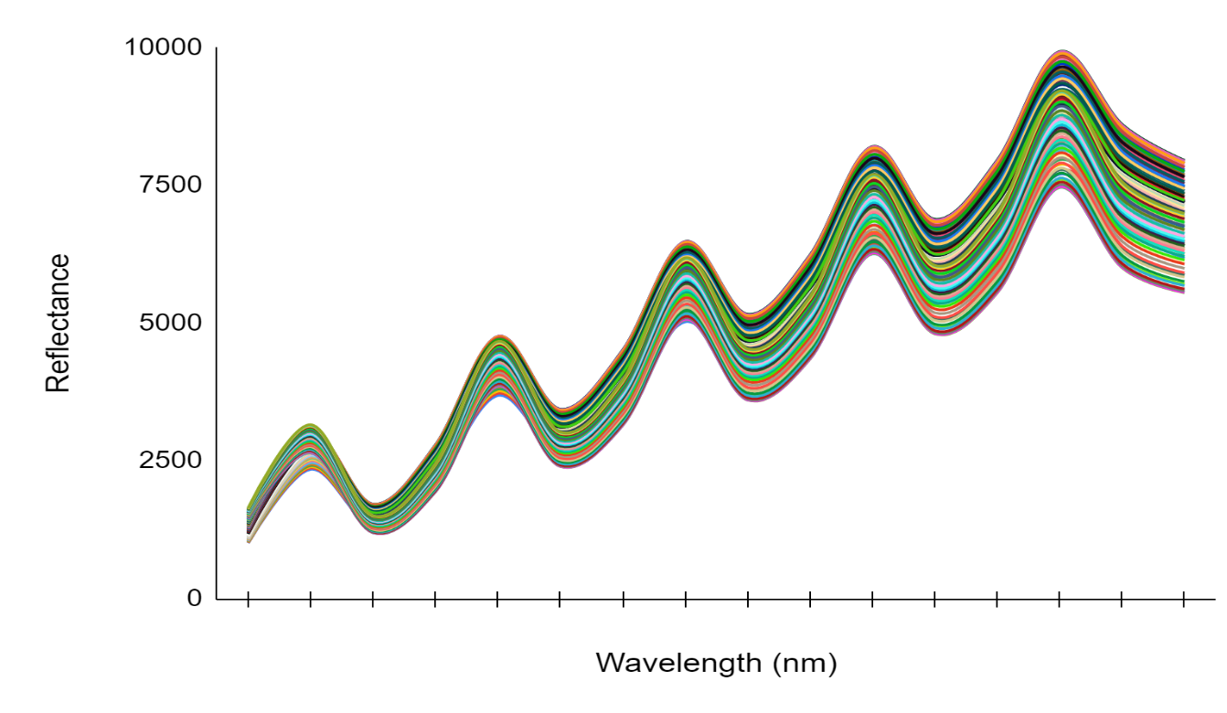
How to distinguish additive and multiplicative effects
(Fictional) example of an additive effect of
a rising baseline. Source: IRSTEA Montpellier
Handmade example of NIR spectra with combined effect (additive and multiplicative) Source: WUR
Notes:
The effects observed in Figures 2 and 3 can be combined, giving rise to an additive effect with increasing baseline of type aX + b, where the dispersion increases with the level of the spectrum and not with the wavelength.
Jean Michel shows spectra with increasing baselines in a Fictional example in Figure 4 (Roger, 2019): “The mean spectrum of the maize dataset was replicated 80 times and each replicate was assigned a baseline of equation aλ + b, with a and b positive but random. This is not a multiplicative effect”.
Analogously, Figure 5 shows one handmade example of NIR spectra with an increasing baseline, this time with multiplicative effect added as well. The mean spectrum was repeated 15 times, each time with increasing effects.

Slide 31
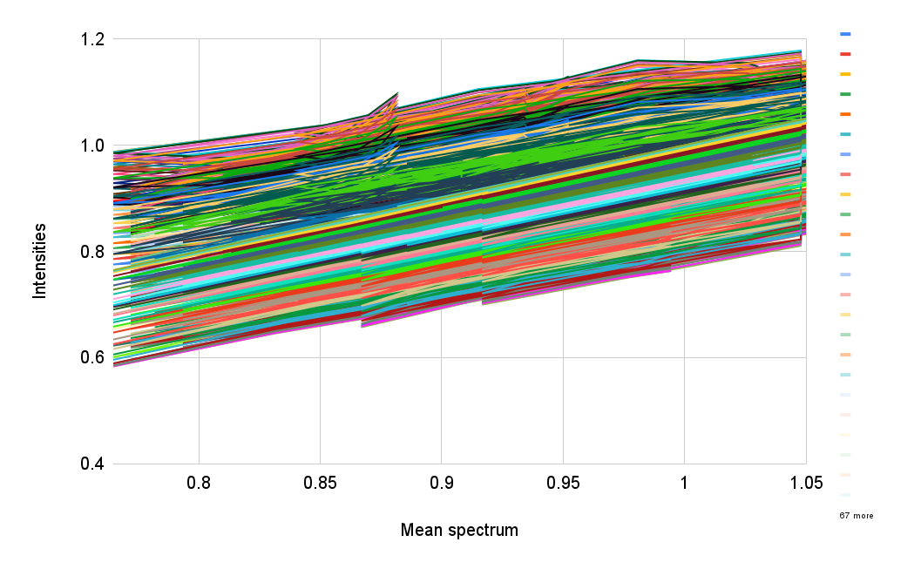
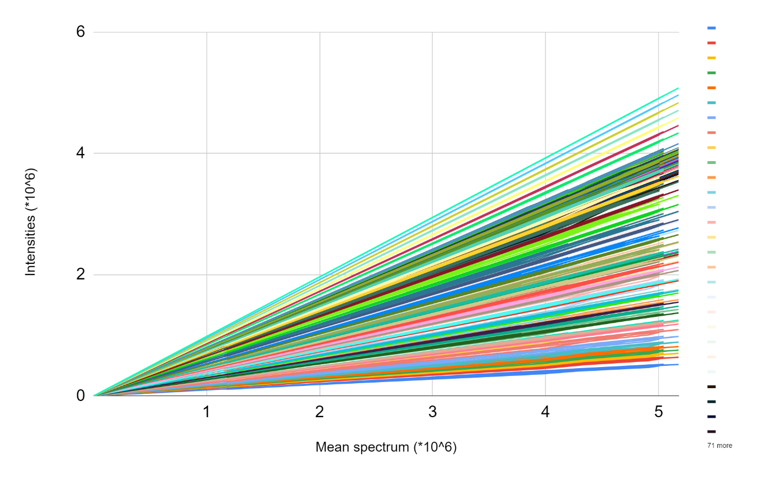
How to distinguish additive and multiplicative effects
A millefeuille shape observed when plotting NIR spectra with additive effect versus the mean spectrum. Source: WUR.
A cone shape observed when plotting
spectra with multiplicative versus their
mean spectrum. Source: from author

Slide 32
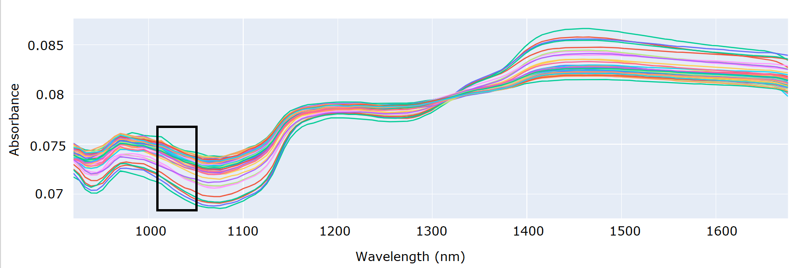
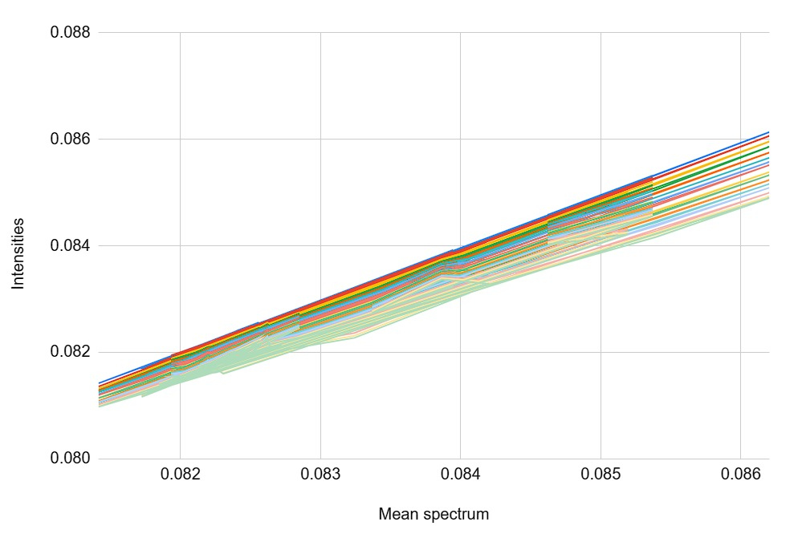
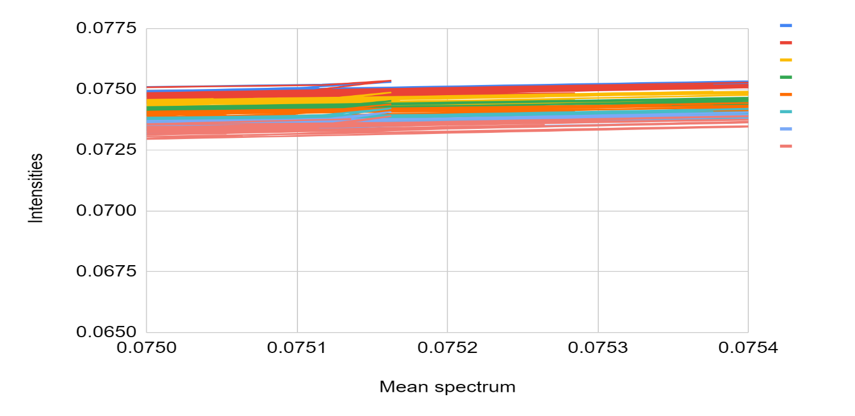
How to distinguish additive and multiplicative effects
Intensities from the black rectangle can be plotted versus their mean spectrum, to understand the type of effect present. Source: WUR
No clear cone neither millefeuille shape shown; difficult to tell if there is additive or multiplicative effect present in spectra. Source: WUR
This shows an additive effect in that spectral range. Source: WUR.

Slide 33
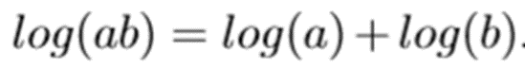





How to reduce a multiplicative effect (k)?
Logarithm
+ Detrend
Normalization
Source: ChemFlow-FUN (France Université Numerique)
Notes:
The figure compares the application of a logarithm and normalization to a dataset with a significant multiplicative effect.
This multiplicative effect is characterized by low variability at low wavelengths and high variability at high wavelengths.
It's important to remember that the logarithm transforms the multiplicative effect into an additive one, hence it is observed that the variability is the same across the entire spectrum. This resulting additive effect could then be further addressed by another adapted pre-processing method, such as detrending.
It can be seen that normalization nearly eliminates the multiplicative effect.
La transformación logarítmica> transforma un efecto multipicativo en un efecto aditivo. Se necesita que x sea estrictamente positive. Por ejemplo, el logaritmo, no puede ser aplicado despues de una derivada. |Esta es la transformación natural de Lambert-Beer.
Se trata de divider el espectro, por un parámetro estadístico que sea sensible al efecto multiplicativo en particular.
Se recomineda evitar divider el espectro por un valor único como el punto máximo, ya que puede tener errores.
Pure multiplicative spectra can be corrected with Normalization only

Slide 34


To remove noise
Detrend
Spectrum of Wheat. Source: IRSTEA Montpellier
Delete the global tendency from the spectrum, modeled by a polynomium
Order 0
Average
Orden 1
Line
Orden 2
Parabola
The residuals that remain after removing the line correspond to the absorbance peaks related to the chemical components of the sample
Source: ChemFlow-FUN (France Université Numerique)
Notes:
Additive effect due to proton diffusion leakage. GROWING BASELINE DUE TO LIGHT DIFFUSION. To reduce the baseline, detrending is used. Increasing trend with the number of wavelengths. This phenomenon is not due to chemistry but to the diffusion of light, whose intensity increases with wavelength (in this range of wavelengths). This spectrum consists of a baseline, upon which an absorbance spectrum is superimposed. DETREND - Removing the overall trend from the spectrum, modeled by a polynomial. Zeroth-order detrend: The polynomial being removed is a constant that corresponds to the average of the spectrum. Order 1 - Identified by linear regression, the line that best fits the spectra is determined and removed. In the case of this corn spectrum, the residuals remaining from this line are the absorption peaks corresponding to the sample's chemical components. Order 2 - A parabola or cubic function is identified and removed from the spectrum

Slide 35


Detrend
Raw spectra
Detrend order 0
Detrend order 2
Source: ChemFlow-FUN (France Université Numerique)
Notes:
La figura muestra el efecto de la correccion detrend en los espectros. Se ve claramente que el orden cer reduce las translaciones verticals puras. El orden 1 reduce las lineas de base más finas, como esa ecuación (recta). El orden dos no aporta gran cosa.

Slide 36


To remove noise
Savitsky Golay
polynomial of degree d
w(odd)>d
At each point i in the spectrum, the raw value xi is replaced by zi from a polynomial fitted over a window around point i.
Source: ChemFlow-FUN (France Université Numerique)
Notes:
This type of filter can be implemented with different algorithms.
Moving Average or Moving Median: Each point in the spectrum is replaced by the mean or median of the values in a window around point i. The width of this window is a parameter to be set. The wider the window, the smoother the spectrum will be. The mean is adapted to remove noise with zero mean, like Gaussian noise. To remove random spikes with non-zero mean, such as digitization artifacts, the median is used.
MEAN: The arithmetic mean or average is calculated by summing all observed values and dividing by the number of observations. The mean is the simplest way to summarize a single variable and is generally the best measure of central tendency for the purposes of statistical inference.
MEDIAN: The median is the middle or central value of a set of observations. To find the median, the values must be ordered. If the total number of elements in the data set is even, the median is calculated as the average of the central numbers. If the total number of elements is odd, then the median is the value located in the center of the list. The median is useful for variables such as ages, incomes, turnovers, and housing prices.
MODE: The mode is the most frequently occurring value in a data set. A data set can have more than one mode. The mode is useful when the most common feature or value in a data set is needed.
This is a polynomial smoothing applied over a moving window.
At each point I in the spectrum, the raw value xi is replaced by zi from a polynomial fitted over a window around point i.
NOTE: The entire spectrum is not replaced by the polynomial. It's the central ordinate of the window that is replaced by the central ordinate of the polynomial.
Two parameters must be set for this algorithm: the width of the window (w) and the degree of the polynomial (d). The larger the w, the smoother the spectrum.
The higher the degree of the polynomial, the less smooth the spectrum. For computational reasons, w must be an odd number, and w must be greater than d.
Spectrum Smoothing
Increases the Signal-to-Noise Ratio (S/N).
If the spectrum is too heavily smoothed, it distorts and loses information.
The algorithm involves convolution between the spectrum and a vector defining the degree of smoothing.

Slide 37




Derivatives
They are also used to decrease the baseline. If the baselines are polynomials of degree K, then the derivatives of order k+1 will make them disappear
Notes:
The concept of the derivative of a mathematical function is intimately related to the notion of a limit. The derivative is understood as the instantaneous variation that a function undergoes, that is, between any two points in its domain that are sufficiently close to each other. It is also used to REDUCE BASELINES.
Let's focus on the signal processing perspective, where the spectrum is considered as a function of wavelength.
In NIR (Near-Infrared), baselines are linear, and a and b are unknown coefficients specific to each sample. In this new derived expression, the proportionality with C is found, which is necessary for calibration. However, the resulting spectrum of this transformation has nothing to do with absorbance. The derivative only removes the baseline.
As it is composed of absorption peaks, a first derivative will transform these peaks into zeros. The Savitzky-Golay algorithm (SG) is widely used for the spectral derivative of near-infrared spectra. SG performs local least-squares regression, providing high computational efficiency for the algorithm.
A first-order derivative can eliminate a constant baseline (offset), and a second-order derivative can also eliminate the slope.
The maxima and minima points of the original peaks have a Y value of zero in the first derivative.
The maxima and minima points in the first derivative curve are the points of maximum rate of change.
The first derivative is useful for revealing peaks that appear as shoulders in the original spectra.
It shows the rate of change across the spectrum.
Use the second derivative to find the exact location (center) of the shoulders in the original spectra.
Significantly narrower bands. Peaks appear at the same locations as in the original spectrum.
The second derivative has more baseline noise than the first derivative. For each derivative operation you perform, the noise level increases slightly, signal intensity decreases drastically, and the signal-to-noise ratio decreases. This is why the application of derivatives is done with algorithms that simultaneously smooth and derive.
. The application of the second derivative allows the deconvolution of the two peaks in the mixture.

Slide 38


Standard Normal Variate (SNV)
The SNV pre-processing of a spectrum X consists of removing the mean of X at each of its points, then dividing them by the standard deviation of X.
Xc = X – mean XSNV = Xc / SD(Xc)
SNV NIR spectra of honey. Additive and multiplicative effects are gone.
Source: SENASA (Argentina)
NIR spectra of honey, with both additive and multiplicative effects. Source: SENASA (Argentina)
Notes:
The Standard Normal Variate algorithm (SNV) allows to process both additive effect and multiplicative effects (R.J.Barnes, 1989). (R.J.Barnes, Correction to the description of standard normal variat (snv) and detrend (dt) transformations in practical spectroscopy with applications in food and beverage analysis,, 1993)
Jean Michel Roger explains it in his report in written in 2019:
“The SNV pre-processing of a spectrum X consists of removing the mean of X at each of its points, then dividing them by the standard deviation of X. This is a centering/ reduction calculation, but performed on the rows of the spectra matrix, instead of the columns. SNV is the combination of a Detrend of order 0 and a normalization by the standard deviation. As a consequence, SNV standardises each spectrum to have mean 0 and standard deviation 1 (Roger, 2019).
This preprocessing can be applied to a single spectrum and does not require any parameter setting. The SNV algorithm is given by the following sequence:
Xc = X – mean XSNV = Xc / SD(Xc)
Where 1 is a P-dimensional vector containing only 1s and P is the number of wavelengths.
Note: If you apply ^{1s}t derivative in first, it leads to a constant spectrum and then SNV is even not applicable ; but you can apply SNV first and then derivative”. (Roger, 2019)

Slide 39
Multiplicative Scatter Correction (MSC)
“Mathematically, if we call Xm​ the mean spectrum, the multiplicative scatter correction is done in two steps.
We first regress each spectrum Xi​ against the mean spectrum
This is done by ordinary least squares: Xi​≈ai​+bi​Xm​ .
We calculate the corrected spectrum msc=()/Ximsc​=(Xi​−ai​)/bi​”
Source:https://nirpyresearch.com/two-scatter-correction-techniques-nir-spectroscopy-python/
Notes:
One of the most frequently reported techniques in the literature is that of multiplicative signal correction (MSC) [16]. The methodology involves regressing each spectrum in a set of related samples, i.e., the samples comprise the same chemical components, on a reference spectrum (for example, the mean spectrum) to estimate the intercept and slope of the estimated regression equation that will theoretically capture the information relating to the effect of multiplicative light scattering. Each individual spectrum is then corrected by subtracting the intercept and dividing by the slope
Multiplicative Scatter Correction (Geladi et al., 1985), as its name indicates, is typically used to compensate for light scattering effects and changes in path length. Indeed, light scattering from solid samples and emulsions can result in multiplicative deviations that are dependent on the wavelength (Heise & Winzen, 1985). MSC minimizes these deviations by fitting a linear model between a reference spectrum and other spectra of the dataset using the linear least squares method. The reference spectrum is often chosen as the average of all spectra in the dataset. The model coefficients are used to compute the ideal (i.e. msc corrected) spectra. Following application of MSC, all spctra appear to have the same absorbance level. MSC and SNV usually lead to similar results. However, as mentioned, MSC requires the use of a reference spectrum while SNV does not.
MSC requires a reference spectrum to start with. This is the most important difference between MSC and SNV. The reference spectrum is ideally a spectrum free of scattering effects.
if the data is reasonably well behaved, we can take the average spectrum to be a close approximation to the ideal spectrum we are after. Particle size and path length effects should vary randomly from sample to sample, and therefore the average should reasonably reduce these effects, at least in the approximations that these effects are genuinely random. This is the main assumption behind MSC.
WE assume that baselines are linear. That is not always the case. Diffuse reflection can cause that baselines are polynomial. Second order polynomial

Slide 40
Notes:
Preprocessing methods in vibrational spectroscopy may be divided into two categories, namely filtering methods and model-based methods. The filtering methods, like calculating second derivatives or performing vector normalization, simply transform spectra into a presumably “better” version of the same data, removing some undesired types of variation. Model-based methods, on the other hand, allow for quantifying and separating between the different types of physical and chemical variations in the spectra. Hence, the information filtered is not lost, but statistical estimates of the mathematical parameters involved in the filtering are obtained and can be used to study the different effects separately
EMSC has been shown to be a reliable tool to correct for additive baseline effects, multiplicative scaling effects, and interference effects.

Slide 41
Notes:
While many types of spectroscopic selectivity problems are of an additive nature (e.g. absorbance effects of chemical interferents), others have a strong multiplicative component. Examples of the latter are light scattering variation or optical path length variations. If these vary uncontrollably from sample to sample, it is advantageous to reduce their effect in the preprocessing stage. Otherwise their multiplicative nature may otherwise destroy the subseq

Slide 44

Notes:
We move directly to hands on data… I have already explained this feature selection in the previous presentation

Slide 45
Part 4: Feature selection methods
"Aristotle: Nature operates in the shortest way possible"

Slide 46

Feature selection
Increasing the number of variables:
Introduces unnecessary NOISE for discrimination, especially if they are strongly correlated
Carries a risk of OVERFITTING the models
Using a simple model with few variables has a better chance of being generalized to a new sample than a model with hundreds of variables, which may fit the training set perfectly well but has limited generalization power
3 Approaches:
Variable Transformation and/or Selection
Discretization
Group Summary
Notes:
Además, si se construye un modelo con la intensión de ser utilizado en rutina, es generalmente más eficaz y económico, tener que medir solo algunas variables.
A pesar de que algunos métodos como PLS puede tolerar la redundancia de variables.
Predictive models use relationships between one or more features to predict the value of a response feature, such as power.
However, including additional predictors like the color of the car that are unrelated to the response will not provide additional benefits and may even affect the model's performance.
The goal of feature selection is to enhance your model by retaining only the features that add value and discarding the rest.
The resulting model will also be simpler to interpret and more computationally efficient.

Slide 47



Variable transformation
TRANSFORMACION DE VARIABLES
This involves applying an equation to existing variables to create a new feature
Example: Is it possible to accurately classify the health status of each individual from the original variables of age, height, weight and location?
BMI= Weight (Kg)
Height (m)²
No clear correlation
Correlation
Notes:
For example, consider this dataset containing information about hospital patients, with one row for each individual.
The initial question is, "Is it possible to accurately classify the health status of each individual from the raw variables of age, height, weight, and location?" To start, we can input the raw variables into a model and attempt to compare, for instance, health status with weight or height.
However, a quick visualization reveals that these variables on their own are not good for predicting health status because there is no clear correlation. So, what can we do?
Well, you can begin the process of feature engineering. It is possible to enhance a model's predictive power by applying domain knowledge to generate useful features. There might be many features that are better predictors of a patient's health status than the original variables on their own. Visualizing the BMI (Body Mass Index) shows that it is indeed more correlated with the patient's health status than weight or height alone.
The second approach of discretization involves dividing the data into groups using a numerical variable. This can be helpful because sometimes the important aspect of a variable is not its exact value but the range in which it exists.
For instance, the age variable naturally lends itself to grouping patients into three categories: child, adult, and senior. You can then add this categorical variable as a new feature to the table.
Discretization is the process by which we can transform continuous variables, models, or functions into a discrete form. This is done by creating a set of continuous intervals (bins) that span the range of our desired variable, model, or function.
Why Discretization is Important: Mathematical problems with continuous data have an infinite number of degrees of freedom. Sometimes, it's necessary to limit these degrees of freedom because calculations cannot go on indefinitely.
Finally, the third approach is to summarize groups within your data. For example, how does a patient's weight compare to the rest of their age group? To find out, calculate the average weight for each category.
Then, append this result to your table as a new variable. Next, you can calculate the difference between each individual's weight and the average.
Each of these approaches can be applied to any dataset. However, the exact implementation depends on your knowledge of the data itself. In theory, you can generate an infinite number of new features, but only a few will prove to be truly useful.

Slide 48
Variable selection methods
Filter
Wrapping
Embedded
Notes:
Hay tres tipos de métodos de selección de funciones, envoltorio, incrustado y filtro.
FILTER METHODS.
Filter methods are used before training the model. They are based on the statistical properties of the predictors and their relationship with the response.
FILTERS: Filters are used for a preliminary variable selection before more sophisticated methods. That is, they are typically used in combination with wrapper and embedded methods.
They involve evaluating the intrinsic characteristics of the data independently of the specific problem considered. They can be applied regardless of the model.
Select a significance level α (e.g., α = 0.20 or α = 0.157). • Conduct K univariate models. • Use all variables in a multivariate model with a univariate p-value < α. • Sometimes followed by backward elimination.
Simple method, can be calculated by any computer, but it only works properly with UNCORRELATED VARIABLES
A Filter method Example: Variance Thresholds
Here, we simply compute the variance of each feature, and we select the subset of features based on a user-specified threshold. E.g., “keep all features that have a variance greater or equal to x” or “keep the the top k features with the largest variance.” We assume that features with a higher variance may contain more useful information, but note that we are not taking the relationship between feature variables or feature and target variables into account, which is one of the drawbacks of filter methods.
Forward Selection:
Select a significance level α1.
Estimate the model.
Repeat:
While the most significant term has p < α, add it and re-estimate. Variant: Forward, in steps.
Select two significance levels α1 and α2.
Repeat:
While the most significant term excluded has p < α1, add it and re-estimate.
While the least significant term included has p > α2, remove it and re-estimate.
Backward Selection:
Select a significance level α2.
Estimate the full model.
Repeat:
While the least significant term has p > α2, remove it and re-estimate. Variant: Backward, in steps.
Select two significance levels α1 and α2.
Repeat:
While the least significant term included has p > α2, remove it and re-estimate.
If the most significant term excluded has p < α1, add it and re-estimate.

Slide 49
Wrapping
methods
These variable selection methods depend on model performance. It is an iterative process of back and forth, where the chosen features are evaluated in relation to the final model performance in sequential stages.
Variable
Train the model
Variable
Best features
Variable
Variable selection
Evaluation of model performance
Optimized model
Notes:
Wrapper methods train a new model for each subset and use the model's error rate on a hold-out set to score feature subsets.
This involves an iterative process between feature subset selection stages and subset evaluation stages using the chosen learning method.
The forward method works as follows:
Without loss of generality, let's consider a regression problem. It starts by selecting the variable that best addresses the problem, meaning the variable most correlated with the target variable. Then, it looks for the variable that is most associated with the first one through a multiple regression. This process continues until all variables are introduced. Different criteria are used to choose the best model among the stages performed.
To prevent overfitting: Cross-validation.
we have to train and cross-validate our model for each feature subset combination

Slide 50

Covariance
Indicates the degree of joint variation between two random variables with respect to their means
It can be used to understand the direction of the relationship between two variables
The correlation coefficient is equal to the covariance divided by the product of the standard deviations of the variables
Notes:
La covarianza mide la relación lineal entre dos variables. Aunque la covarianza es similar a la correlación entre dos variables, difieren de las siguientes maneras:Los coeficientes de correlación están estandarizados. Por lo tanto, una relación lineal perfecta da como resultado un coeficiente de 1. La correlación mide tanto la fuerza como la dirección de la relación lineal entre dos variables.
Los valores de covarianza no están estandarizados. Por consiguiente, la covarianza puede ir desde infinito negativo hasta infinito positivo. Por lo tanto, el valor de una relación lineal perfecta depende de los datos. Puesto que los datos no están estandarizados, es difícil determinar la fuerza de la relación entre las variables.
Los valores de covarianza positivos indican que los valores por encima del promedio de una variable están asociados con los valores por encima del promedio de la otra variable y los valores por debajo del promedio están asociados de manera similar. Los valores de covarianza negativos indican que los valores por encima del promedio de una variable están asociados con los valores por debajo del promedio de la otra variable.
Por lo tanto, una covarianza positiva siempre producirá una correlación positiva y una covarianza negativa siempre generará una correlación negativa
However, variance can only be used to explain the spread of the data in the directions parallel to the axes of the feature space.
The diagonal spred is captured by the covariance

Slide 51


Wrapping method: Covariance selection (CovSel)
In each iteration, one variable X is selected on a criterion of the maximization of the covariances with Y
Once the variable with the highest covariance is isolated and selected, all other predictive factors and responses are orthogonalized with respect to it, and the process is repeated until the fixed number of variables has been selected
Notes:
The first stage of CovSel involves evaluating the covariance between the columns of X and Y.
The output matrix X is centered, and the matrix Y is centered and scaled (the intensities of the Y variables are not intended to play a role in the selection).
All covariances between the columns of X and Y can be directly calculated as follows:
The covariance matrix C has dimensions QxP. An element Cij of C gives the covariance between the variable with index I of Y and the variable with index j of X.
The number of variables (L) to be selected from the Xdata block is defined.
The Xblock is centered on the mean, and Y is autoscaled (resulting in Xp and Yp, respectively).
The covariance between each variable Xp (xp, i) and Yp is calculated.
The predictor xSel, l with the highest covariance with Yp is selected.
Xp is orthogonalized with respect to the selected variable xSel, resulting in XO.
After the sixth step, you start again from the third step, replacing Xp with XO, and repeating all the steps L-1 times.
Note that in step 4, Xsel is selected but not removed from Xp.
Also, note that the CovSel algorithm follows the same pattern as the NIPALS PLS. In both, covariance is maximized, but in CovSel, the construction of a latent variable is replaced by variable selection.
CovSel is a variable selection method designed to identify the most relevant features in a regression context. As the name suggests, the relevance of each variable is assessed by estimating the covariance between each predictor and the responses. Once the variable with the highest covariance is singled out and selected, all other predictive factors and responses are orthogonalized with respect to it, and the procedure is repeated until a fixed number of variables has been selected
CovSel aims to iteratively select variables from a predictive variable matrix X with N rows and P columns, which have good predictive capability for the variables combined in a matrix Y with N rows and Q columns. The variables selected in the end will be relatively few in relation to P. The most commonly encountered case is when a single variable needs to be predicted (Q=1), but here we will address the general case where Q can potentially be greater than 1. In each iteration, the variable X is selected based on the criterion of maximizing covariances with Y
CovSel is well adapted to multi-response calibration of spectrometers and can be applied to the problem of discrimination considering indicator variables as responses.

Slide 52
Covariance selection (CovSel)
The selected variables from X should have:
Good predictive power for Y
The highest possible variability
CovSel can be applied to the problem of discrimination considering indicator variables as responses
Notes:
El criterio de la maximización de las covarianzas reposa sobre la idea de que las variables de X seleccionadas deben presenter dos características:
Deben presenter un buen poder predictivo de Y
Deben presenter la mayor variabiliad possible. De la misma manera que en la regression PLS, se tiene interés en dar la mayor importancia a las variables en X que son las más intensas. Como el ruido aleatorio depende en general de sus intensidades, la elección de una variable intensa aporta menos importancia relativa al ruido.
The criterion of maximizing covariances is based on the idea that the selected X variables should possess two characteristics:
They should exhibit good predictive power for Y.
They should have the highest possible variability. Similarly to in PLS regression, there is an interest in giving greater importance to the variables in X that are the most intense

Slide 53
Embedded
methods
They automatically perform feature selection as part of the model training
The result is a trained model that highlights the useful features and disregards the rest
Train the model
Optimized model
Variable
Variable
Useful variables
Variable
Useless features
Feature selection
Notes:
Integrated methods, or a class of machine learning models, automatically perform feature selection as part of the model training process.
The result is a trained model that emphasizes useful features and disregards the rest.
Both wrapper methods and integrated methods rely on model performance to guide feature selection.
Wrapper methods consider unimportant features iteratively based on the evaluation metric, while Embedded methods perform feature selection and training of the algorithm in parallel. In other words, the feature selection process is an integral part of the classification/regressor model.
An Embedded Method Example: L1 Regularization
L1 (or LASSO) regression for generalized linear models can be understood as adding a penalty against complexity to reduce the degree of overfitting or variance of a model by adding more bias. Here, we add a penalty term directly to the cost function,
regularized_cost = cost + regularization_penalty
In L1 regularization, the penalty term is
L1 : λ Σ^{k}_{i}w_{i}= λw₁,where w is our k-dimensional feature vector. Through adding the L1 term, our objective function now becomes the minimization of the regularized cost, and since the penalty term grows with the value of the weight parameters (λ is just a free parameter to fine-tune the regularization strength), we can induce sparsity through this L1 vector norm, which can be considered as an intrinsic way of feature selection that is part of the model training step.

Slide 54
Part 5: Cross validation and Data Split

Slide 55

Some methods for the selection of Representative Learning and Test Sets
Onion
Kennard-Stone
Randomly
Kernnand Stone
Onion
Duplex
Reducennsamples
Source:https://eigenvector.com/wpcontent/uploads/2022/10/Onion_SampleSelection.pdf
Notes:
The Kennard-Stone (KS) algorithm starts by finding two samples in that have the largest Euclidean distance; these are the two samples furthest
apart. Subsequent points are selected that maximize the Euclidean distance from previously selected points. The result is that, for a given fraction (fraction) of the data to be parsed into the calibration set,
samples are selected to smoothly fill the data space. The remaining samples are placed into the test set.
3) Onion selects an exterior set of samples for calibration and the next exterior layer as test samples. The procedure is repeated for non-onion layers with the remainder interior samples randomly assigned to calibration and test sets. This method first selects a ring of the most unique samples (based on distance from the mean), like the outer most layer of an onion. These are used in the calibration set. Next, a ring of less unique samples, just inside the first set (the next onion layer), is put into the validation set. This is repeated two more times, so there are three outer rings of most unique and less unique samples. Finally, all the remaining samples are split randomnly into calibration and validation.
Distance measure: Euclidean does simple, non-scaled distance. Mahalanobis scales each direction by the covariance matrix (correcting for unusually small or large directions).

Slide 56

Some methods for the selection of Representative Learning and Test Sets
Duplex
Randomly
Randomly
Kernnand Stone
Onion
Duplex
Reducennsamples
Source:https://eigenvector.com/wpcontent/uploads/2022/10/Onion_SampleSelection.pdf
Notes:
Kernnard-Stone selects a subset of samples which uniformly cover the data set and includes exterior samples as the calibration set. The remainder are placed in the test set.
This method selects samples that best span the same range as the original data, but with an even distribution of samples accross that range.
The Kennard-Stone (KS) algorithm starts by finding two samples in that have the largest Euclidean distance; these are the two samples furthest
apart. Subsequent points are selected that maximize the Euclidean distance from previously selected points. The result is that, for a given fraction (fraction) of the data to be parsed into the calibration set,
samples are selected to smoothly fill the data space. The remaining samples are placed into the test set.
2) Reducennsamples
Select a subset of samples by removing nearest neighbors. . Performs a selection of samples which fill out the multivariate space by removing samples which are similar to each other based on nearest neighbor distance. This algorithm is useful in selectin the minimun number of samples needed to define a subspace and reduce the number of reference measurements needed, or amount of data needed to be stored.
Initially, the nearest neighbor of each sample is found along with the distance between the neighbors. Of the two nearest samples, one is excluded from the data and the distances are recalculated. This process is repeated until the either the smallest distance between samples reaches a maximun limit, or the number of samples reaches a lower limit.

Slide 57
Cross validation
Leave One Out:
Over-estimates the predictive capacity of the model
Use only when data set has few samples
Notes:
"The most commonly used method for determining the optimal number of latent variables is cross-validation, which calculates the accuracy of predictions for models with an increasing number of latent variables. In its simplest implementation, the data matrix is repeatedly split into two parts, one part (calibration samples) is used to build calibration models with different numbers of latent variables, and the other part (validation samples) to calculate prediction errors.
After applying this procedure to all samples, for each of the models with different numbers of latent variables, an average value for the sum of squared prediction errors, or PRESS, is calculated. The optimal dimensionality for the PLS regression model is the one that minimizes this PRESS or RMSECV value.“
"To increase the precision of the predictive model, it is useful to perform the validation experiment multiple times, reassigning observations to different sets.
General outline of cross-validation: In practice, the calibration set is divided into separate segments of the same size. Each segment forms a validation set each time. The division can be done in various ways. One particular case is Leave One Out, where one sample is removed at a time. Leave One Out: Overestimates the predictive capacity of the model."

Slide 58
Part 6: Discrimination (PLSDA)

Slide 59
Principles and Objectives of Discrimination
We have a data matrix (nxp) where n samples
were measured for p quantitative variables, and a vector Y
of size n measured on the same samples
This vector represents the membership of each sample to each class K
Each class contains at least one sample, and each sample belongs to a single class
Notes:
"The principal components are NOT related to the response Y.
They are ordered based on the variability of the X variables, but NOT the response Y.
PCA is only an exploratory tool and only represents the variability in X
It is important to have things clear and to be in the same page

Slide 60
Partial Least Squares Discriminant Analysis
Objective: To achieve a linear transformation that maps the data into a lower-dimensional space with the least possible error
Supervised version of PCA
In PCA, the transformation preserves (in its first principal component) the maximum possible variation in the original data
In PLS-DA, the transformation preserves (in its first principal component) the maximum possible covariance between the original data and their labeling
Both can be described as iterative processes in which the error term is used to define the next principal component
Notes:
Partial Least Squares Discriminant Analysis (PLS-DA) is a linear classification method that combines the properties of Partial Least Squares regression with the discriminative power of a classification technique. PLS-DA is based on the PLS regression algorithm (PLS1 when dealing with a single dependent variable Y and PLS2 in the presence of multiple dependent variables Y) which seeks latent variables with maximum covariance with the Y variables. Relevant sources of data variability are modeled by these latent variables (LV), which are linear combinations of the original variables, allowing for graphical visualization and understanding of different data patterns and relationships through the scores and loadings of LV.
PLS1 – Variance is extracted individually for each y. A different set of factors for each y.
PLS2 – Variance is related to several y variables simultaneously. Only one set of factors.
PLS-DA can be considered a 'supervised' version of Principal Component Analysis (PCA) in the sense that it achieves dimensionality reduction but with full awareness of class labels. Besides its use in dimensionality reduction, it can be adapted for feature selection as well as for classification. The goal of dimensionality reduction methods like PCA and PLS-DA is to find a linear transformation that maps the data into a lower-dimensional space with minimal error. If we think of the original data matrix as a collection of m-dimensional vectors (i.e., X is an x by m matrix), the above objective can be seen as finding the transformation matrix A of am × d that optimally transforms the data matrix X into a collection of n d-dimensional vectors S. Hence, S = XA + E, where E is the error matrix. The S matrix, with its rows corresponding to the transformed vectors, provides d-dimensional scores for each of the n vectors in X. In PCA, the transformation preserves the maximum possible variation in the original data (in its first principal component). In PLS-DA, the transformation preserves the maximum possible covariance between the original data and its labeling (in its first principal component). Both can be described as iterative processes where the error term is used to define the next principal component. As mentioned earlier, PCA and PLS-DA are seen as unsupervised and supervised counterparts of dimensionality reduction tools. The new features representing the reduced dimensions are known as principal components.
PLS Discriminant Analysis (PLS-DA) is performed to enhance the separation between groups by rotating the PCA (Principal Component Analysis) components to achieve maximum class separation and to understand which variables carry class separation information. PLS-DA consists of a classical PLS regression where the response variable is a category expressing unit class membership. Therefore, PLS-DA does not allow for response variables other than defining the groups of individuals. As a result, all measured variables play the same role in terms of class assignment. In reality, PLS components are created by trying to strike a suitable compromise between two purposes: describing the set of explanatory variables and predicting the response variables. A classification based on PLS should benefit from this property towards constructing typologies with intrinsic predictive power."

Slide 61


Partial Least Squares Discriminant Analysis
It consists of a classical PLS regression where the response variable is a category expressing the membership of samples in classes
The relevant sources of data variability are modeled by the Latent Variables (LVs) which are linear combinations of the original variables
A fictitious matrix (Y) that records membership with 1s and 0s is combined with a spectral set (X), and PLS is implemented in the normal manner
Notes:
It consists of a classical PLS regression where the response variable is a category expressing the membership of samples in classes. All measured variables play the same role with regard to class assignment.“
Rotating the A (Principal Component Analysis) components is also performed in order to achieve maximum separation between classes and to understand which variables carry the class separation information
The PLSDA calculation procedure consists of the following stages:
Construction of the complete disruptive code for the matrix Y associated with Y,
Using the PLS2 method, with the quantitative variables X as predictors and Y as the matrix to predict
DISRUPTIVE CODE: It is observed that to create this complete disruptive code Y associated with y, the matrix has as many columns as classes, and each row contains only one membership. The rank of Y is equal to K-1

Slide 62
Partial Least Squares Discriminant Analysis
PLS-DA provides estimated values for each sample and for each class.
These values will not be exactly 1 or 0; however, if the calculated y is closer to 0, then the sample likely does not belong to that class, while a value closer to 1 would indicate the opposite
To make a class assignment, a threshold can be defined for each class
Thresholds can be calculated on the basis of the Bayes theorem
Notes:
PLS-DA devuelve valores estimados para cada muestra y para cada clase. Estos valores no serán exactamente 1 ni 0; sin embargo, si ycalculado está más cerca de 0, entonces la muestra probablemente no pertenezca a esa clase, mientras que un valor más cercano a 1 indicaría lo contrario.
To make a class assignment, a threshold can be defined for each class: if ycalcig is greater than the threshold defined for the g-th class, then the i-th sample is assigned to the g-th class, otherwise not. The threshold is selected at the point where the number of false positives and false negatives is minimized. It can happen that the estimated class values for one sample are higher or lower than all the defined class thresholds. Thus, if higher, the sample would be assigned to all classes and, accordingly, would be a confused sample. Conversely, if lower, the sample would not be recognised as member of any class. In both cases, the sample can be defined as ‘not assigned’.
Thresholds can be calculated on the basis of the Bayes theorem. This assumes that the estimated values follow a relatively normal distribution, which should be comparable to what will be observed for future samples.

Slide 63


Notes:
Latent variables are determined by CROSS VALIDATION

Slide 64



Slide 65


Slide 66
Part 7: Hands on data

Slide 67
Hands on data: R code https://github.com/MMBDD/Serbia
Name | Functionality
OutlierDetection.R: NEEDED | Removes outliers Averages Spectra from the same Sepal into only One Spectrum per Sepal
GlobalModel.R: NEEDED | Creates PLSDA Classification models with different number of important variables as input for PLSDA
PLSDA.R: OPTIONAL | Creates PLSDA Classification models with optimized parameters using Rchemo
PLSDAmdatools.R: OPTIONAL | Creates PLSDA and SIMCA Classification models using mdatools
MSC.R: OPTIONAL | Pretreats raw data and plots the results

Slide 68
Description of initial datasets

Slide 69
Number of spectra in each class (Healthy: Class 1; Diseased: Class 2) when dataset was split according to different labelling scenarios (Label 1: 0/123; Label 2: 01/23 and Label 3: 0.5/123).

Slide 70
References
https://www.chemproject.org/ChemHouse
https://www.fun-mooc.fr/en/courses/?limit=21&offset=0
Personal Material from the International School of Chemometrics 2023
https://eigenvector.com/wp-content/uploads/2022/10/Onion_SampleSelection.pdf
https://nirpyresearch.com/two-scatter-correction-techniques-nir-spectroscopy-python/
J.M. Roger, B. P., D. Bertrand, E. Fernandez-Ahumada (2011). "CovSel: Variable selection for highly multivariate and multi-response calibration. Application to IR spectroscopy." Chemometrics and Intelligent Laboratory Systems 106(2).
J.M. Roger, B. P., D. Bertrand, E. Fernandez-Ahumada. (2011). CovSel: Variable selection for highly multivariate and multi-response calibration. Application to IR spectroscopy. Chemometrics and Intelligent Laboratory Systems, 106(2). doi:ff10.1016/j.chemolab.2010.10.003f

Slide 71
Thank you for your attention
Please, open your R studio!
Any questions or comments?
Notes:
We continue Hennie’s work

